Slide 1






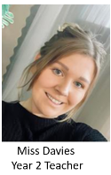
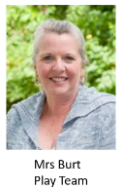
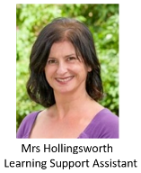
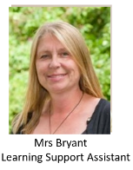
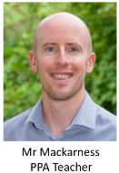
Meet the Teacher
Autumn Term
Parks Class

Slide 2
Today, we will talk about:
Routines, timetable and any other parent/carer information
Year group, class and home-school learning information
Questions at the end

Slide 3


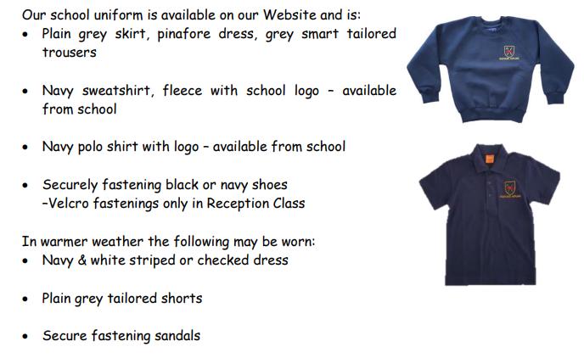
The children look so smart – thank you.

Slide 4


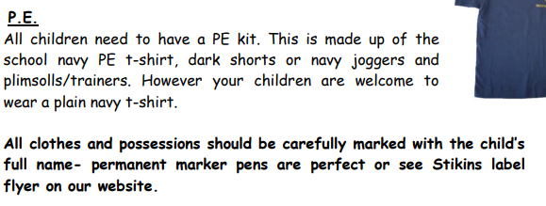


PE Days
Parks Class’s PE days are
Monday and Thursday

Slide 5




Special Mentions
Special Mentions assemblies are every Friday after Rock Up and Read.
You will receive a Ping on the Friday before.
You will also receive a Ping for Merit Star and Maths Mission Awards on the Friday before.

Slide 6


Rock Up And Read
Every Friday at 8:40-9:00

Slide 7
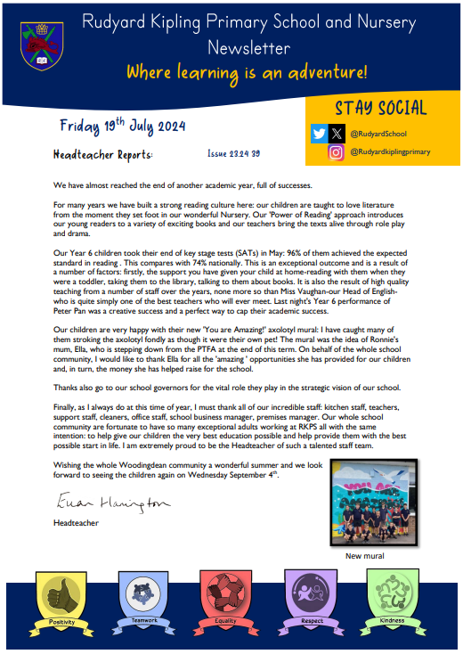

Parent Newsletters and SchoolPing
Use your SchoolPing account to receive important messages.

Slide 8
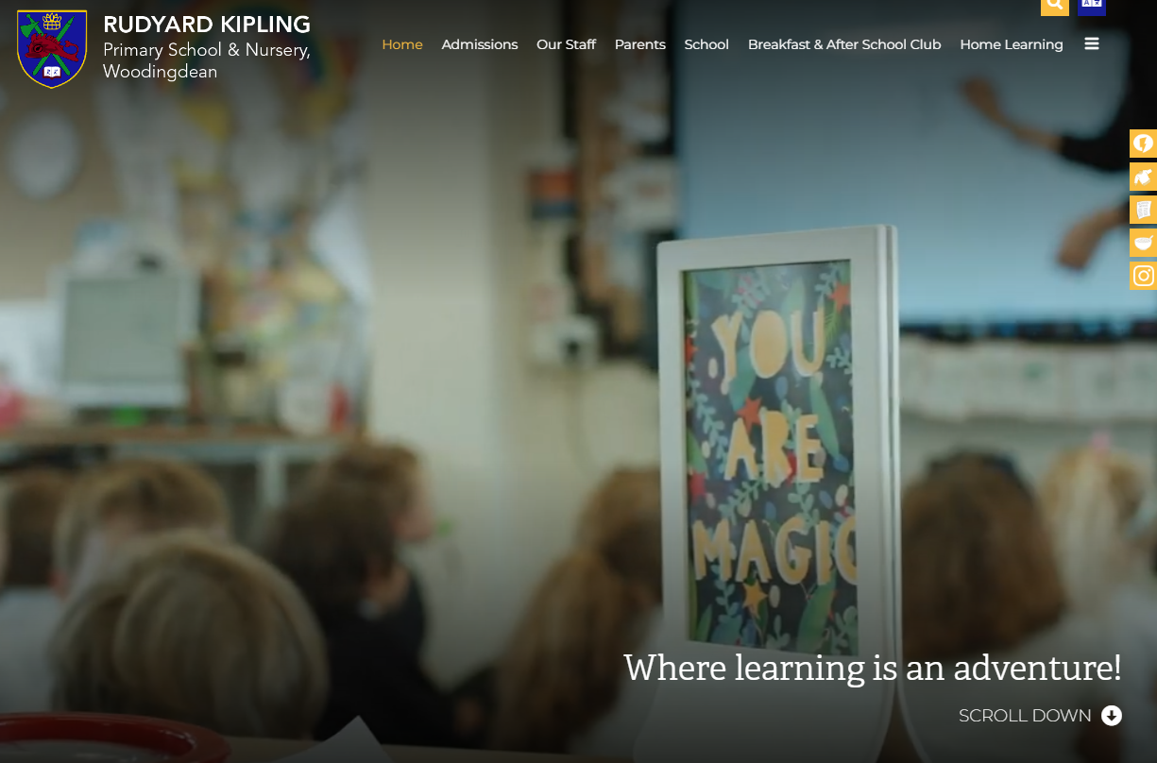
School Website
https://www.rudyardkiplingprimary.co.uk/

Slide 9
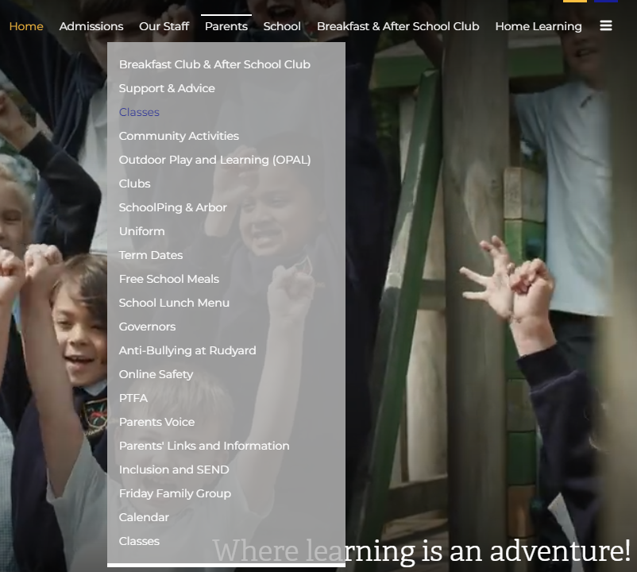
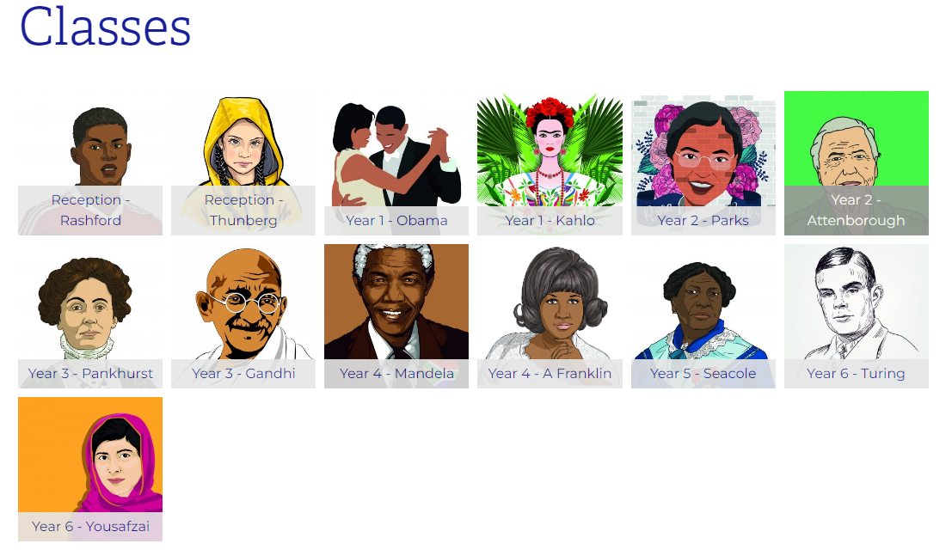
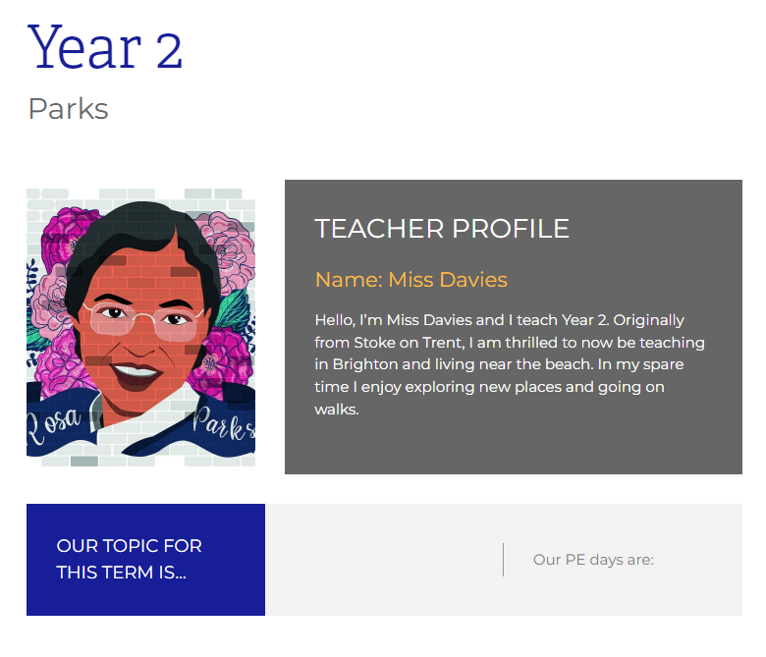
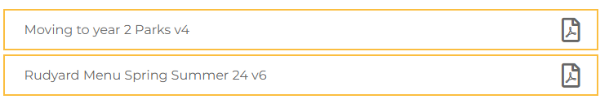
Class Page

Slide 10
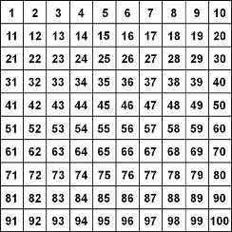

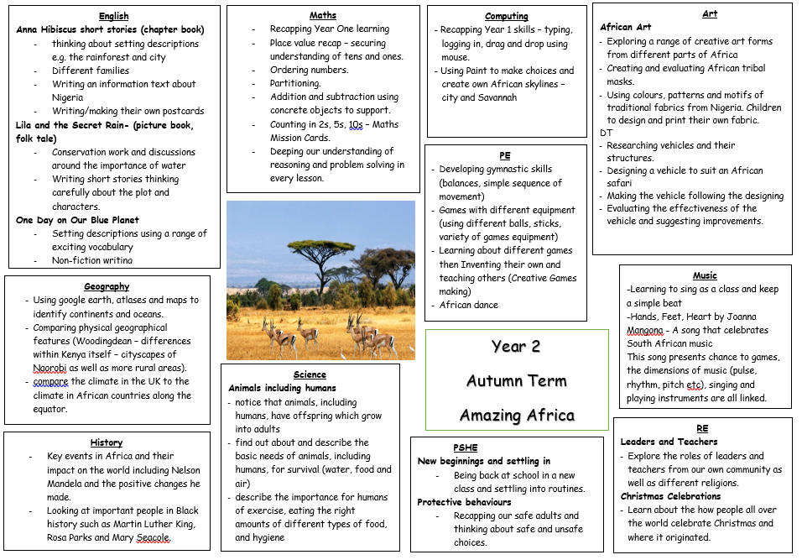






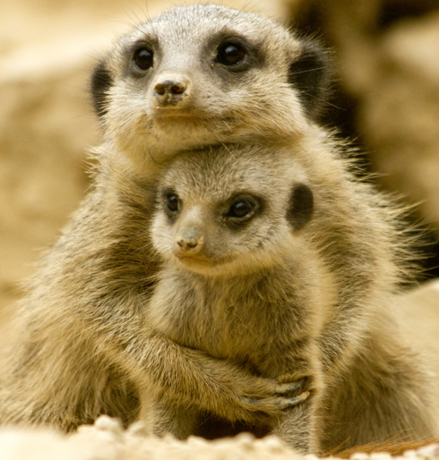


Curriculum Map

Slide 11
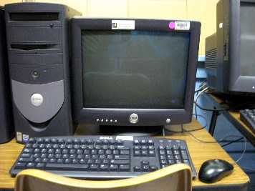



Parks Days for:
Computing: TUESDAY
Library: FRIDAY
Dates TBC:
Christmas show
Upcoming trips

Slide 12

Practise regularly
Increase confidence
Increase fluency
Tackle challenges
Login: surnam:@rkps.me
Password: words123

Slide 13
Reading
Read your reading book 3 times a week
Record this in your reading record
Choose a reading for pleasure book
Hand in your reading record weekly
3 reads = 1 raffle ticket drawn in Special Mentions assembly

Slide 14

How can I support my child with reading?

Slide 15


How can I support my child with spelling?
Year 1 Words
Year 2 Words

Slide 16

Any questions?

