Slide 1
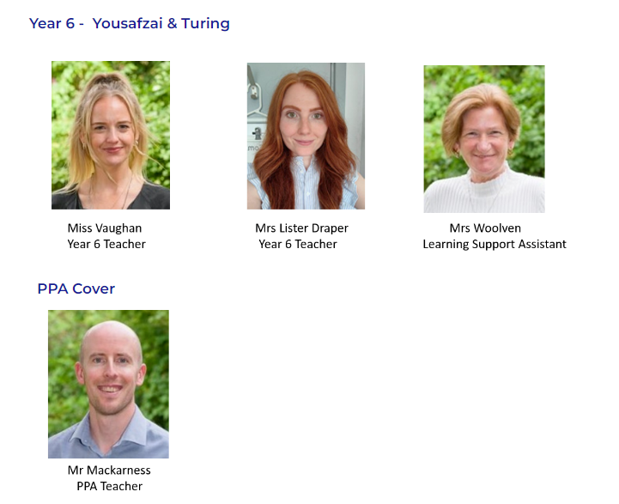
Meet the teacher ☺

Slide 2

Today, we will talk about:
Routines, timetable and any other parent/carer information
Year group, class and home-school learning information
Questions at the end

Slide 3
Classroom
Please enter through the entrance most convenient for you (08:40)
Pick up from the KS2 toilets
Miss Vaughan/Mack will dismiss at the end of the day (15:15)

Slide 4


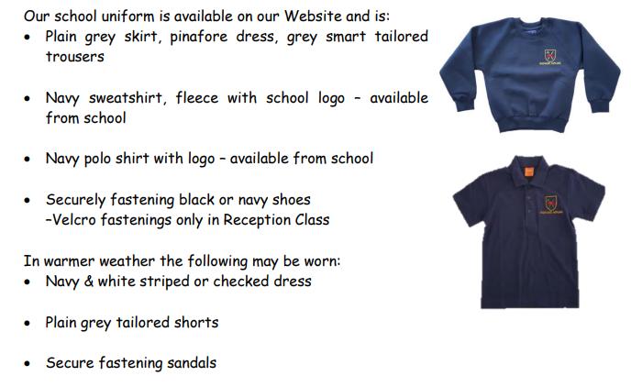
The children look so smart – thank you.

Slide 5
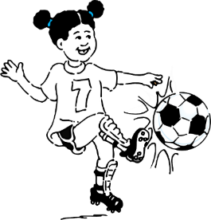

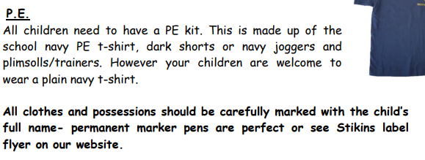

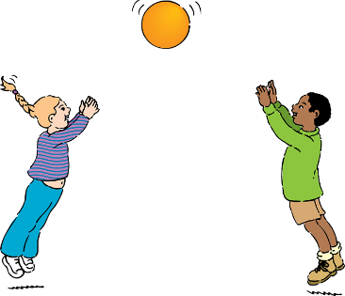
PE Days
Yousafzai’s PE days are
Tuesday

Slide 6
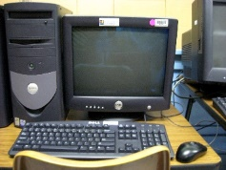



Yousafzai days for:
Computing: MONDAY
Library: Tuesday
Dates TBC:
Christmas show
Upcoming trips

Slide 7

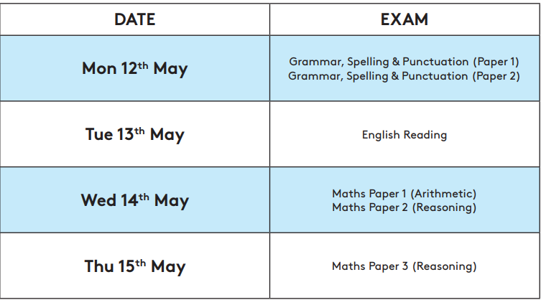
Dates for the Diaries
Victorian Day: TBC
Deadline for secondary applications 31st October 2024
SATS will be held from Monday 12th May 2025 – Thursday 15th May 2024.

Slide 8

Practise regularly
Increase confidence
Increase fluency
Tackle challenges
Login: surnam:@rkps.me
Password: words123

Slide 9




Special Mentions
Special Mentions assemblies are every Friday after Rock Up and Read.
You will receive a Ping on the Friday before.
You will also receive a Ping for Merit Star and Maths Mission Awards on the Friday before.

Slide 10

Rock up and Read & Special Mentions Assembly
Friday morning 08:40-09:00

Slide 11

Reading
Read your reading book 3 times a week
Record this in your reading record
Choose a reading for pleasure book
Hand in your reading record weekly
3 reads = 1 raffle ticket drawn in Special Mentions assembly

Slide 12


Reading - Home
Evidence suggests that reading for pleasure is an activity that has emotional and social consequences
Reading for pleasure has social benefits as well and can make people feel more connected to the wider community. Reading increases a person’s understanding of their own identity, improves empathy and gives them an insight into the world view of others (The Reading Agency 2015).
Reluctant Readers
Book Recommendations

Slide 13
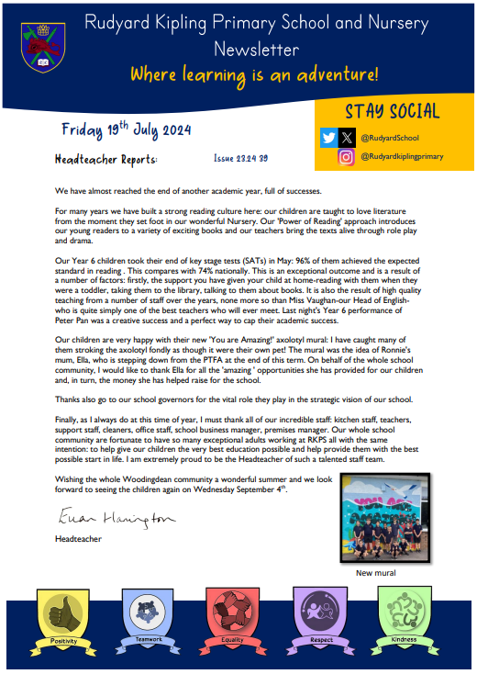

Parent Newsletters and SchoolPing
Use your SchoolPing account to receive important messages.

Slide 14
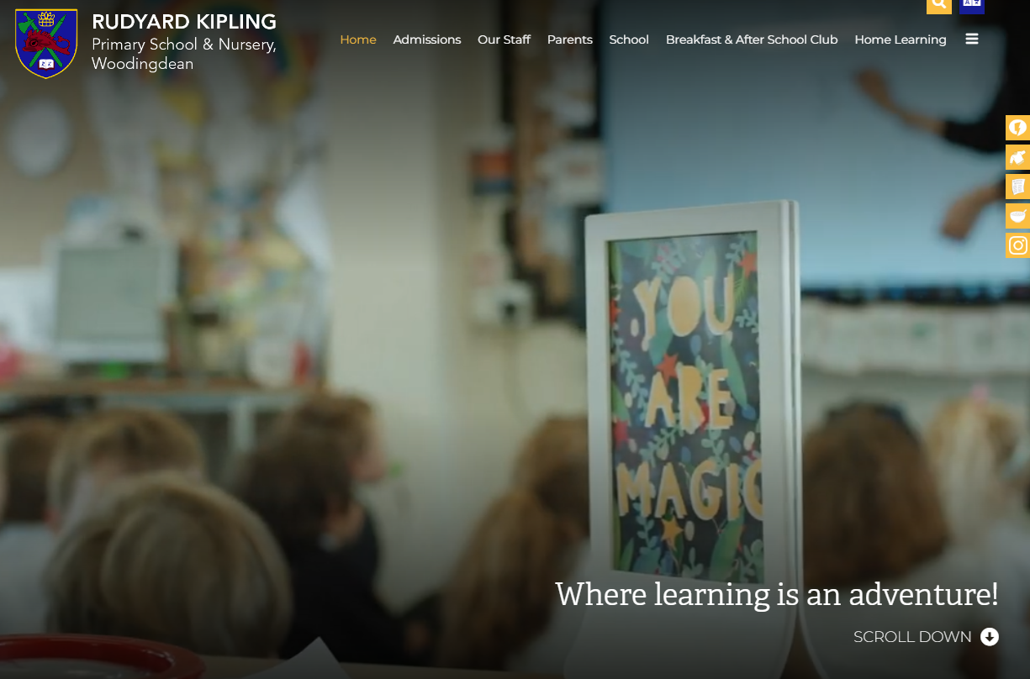
School Website
https://www.rudyardkiplingprimary.co.uk/

Slide 15
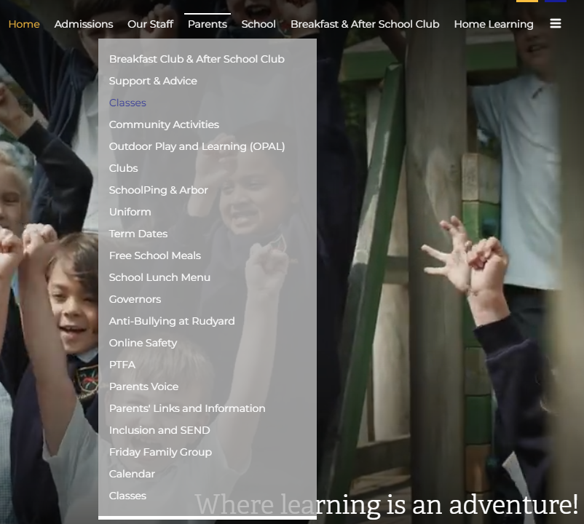
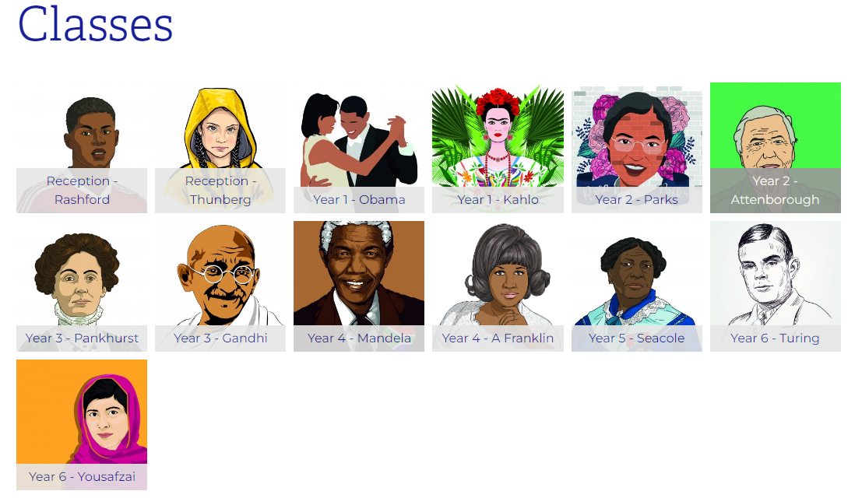
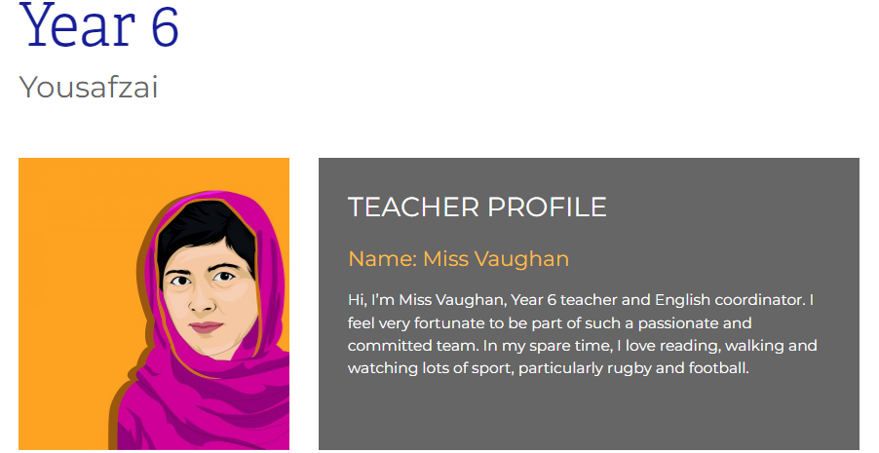
Class Page

Slide 16

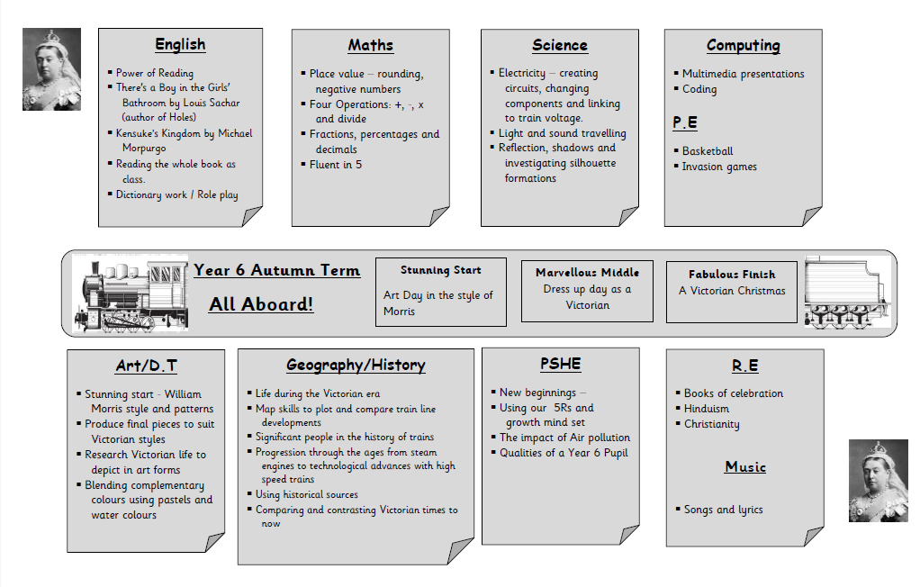
Curriculum Overview:

Slide 17

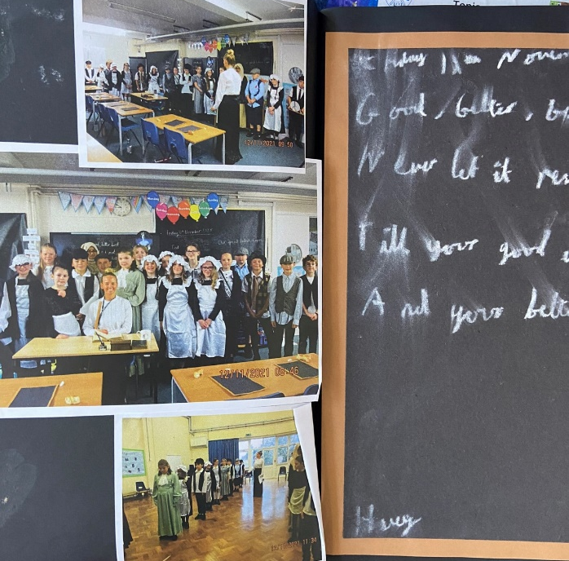
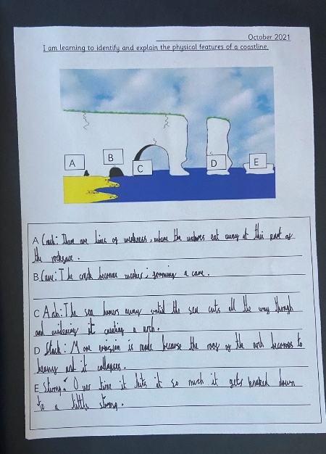
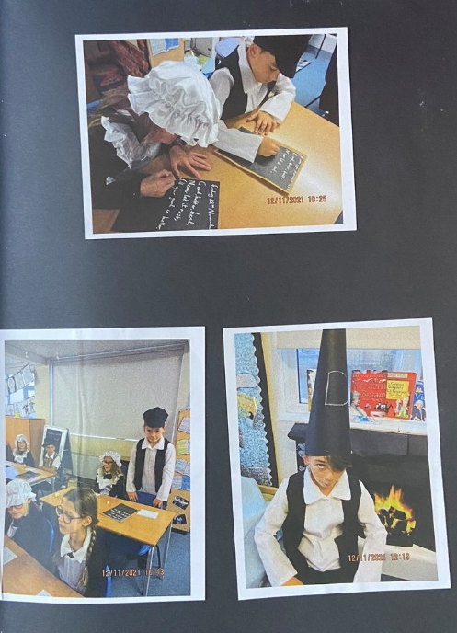
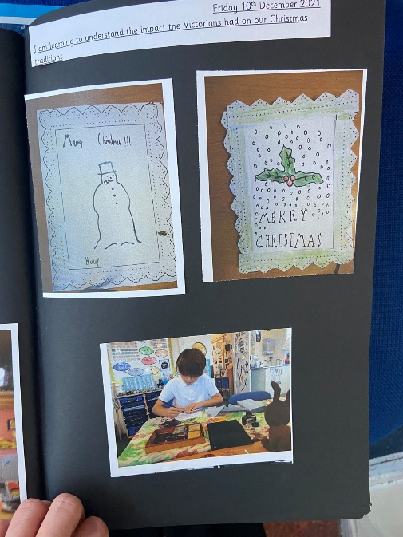
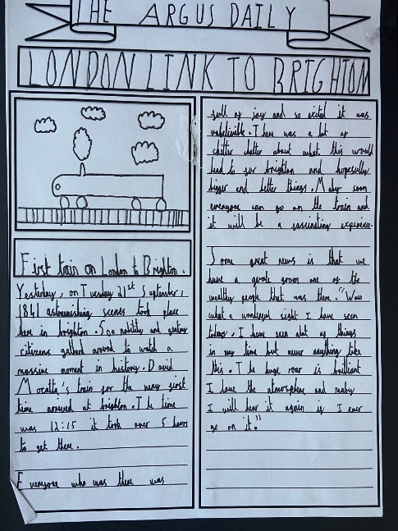
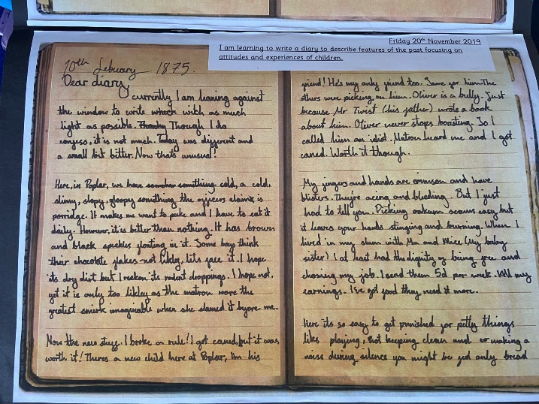

Slide 18
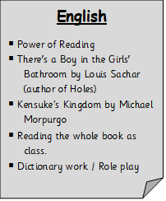

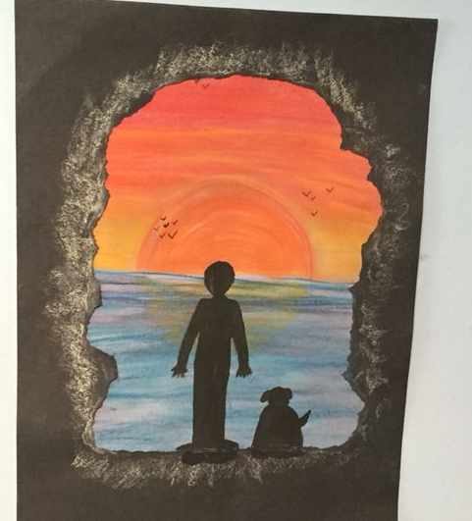
English Overview:
Reading the book as class.
Dictionary work to search for meaning of new words e.g. exhilarating
Make and adapt predictions
Drama:
Role play telephone conversations
Role play being journalists
Writing opportunities fiction and non fiction:
Discussion writing – arguments for and against
News report
Jungle setting description
Diary entries
Letter writing
Write an alternative ending

Slide 19
Fluent in Five
745,245 + 64,154
74,989 – 54,362
324 x 8
856 ÷ 4
5²
Once they have learnt a concept, we don’t want them to forget it. Like everything practise is key.

Slide 20
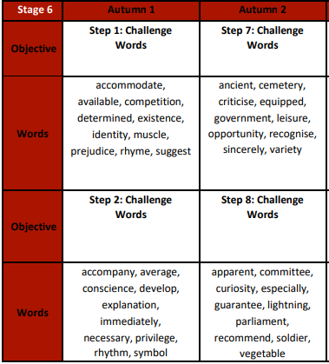
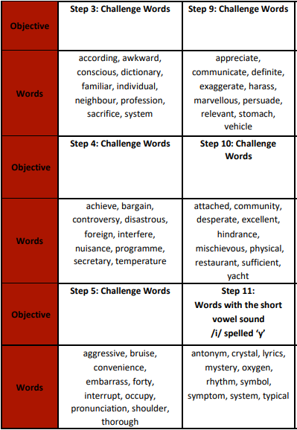
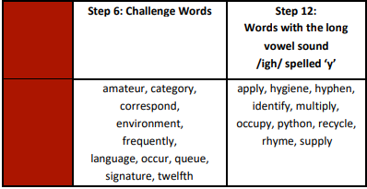
  Spellings
In year 6 we have to review all of KS2 spellings and learn the statuary spelling list for year 5 and for Year 6.
During Autumn, we will be focusing on:
Statuary spellings for year 3 & 4 and 5 & 6.

Slide 21





Home Learning apps
TTRS; Spelling Shed; Google Classroom:
Logins: surnam:@rkps.me
Password: words123
Duolingo; White Rose 1minute maths: Free Apps

Slide 22

Any questions?

Slide 27

  Spellings
There are many different strategies of learning to spell…
Here are a few…

Slide 28
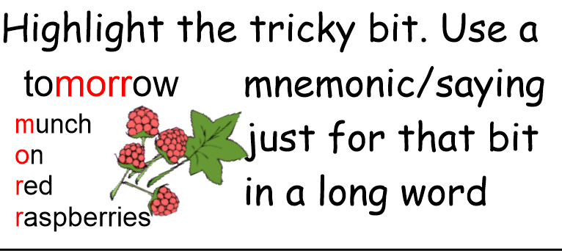
  Spellings

Slide 29
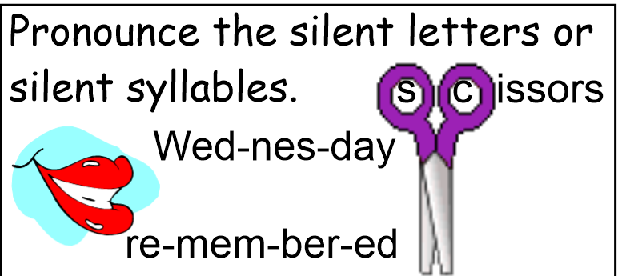
  Spellings

Slide 30
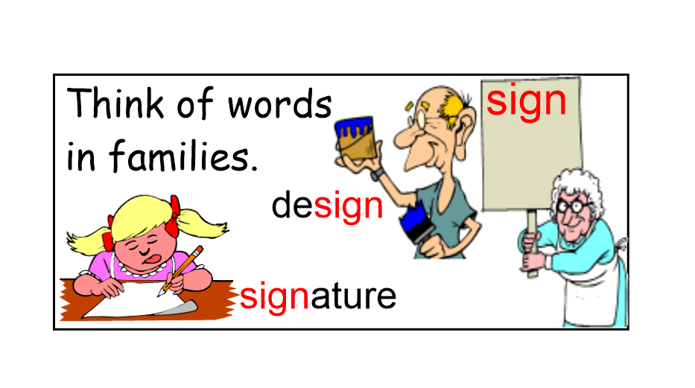
  Spellings

Slide 31
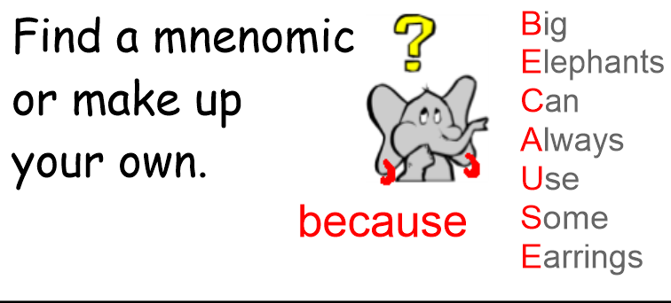
  Spellings

Slide 32
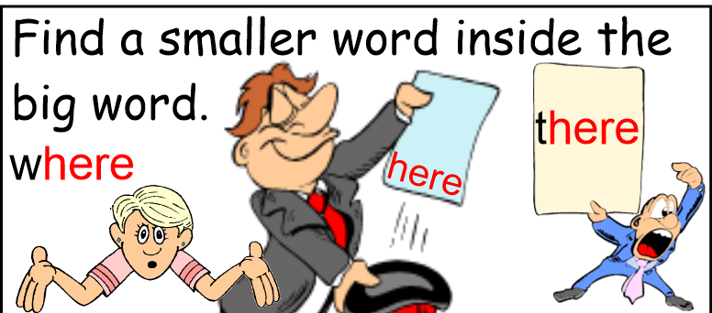
  Spellings

