Slide 1
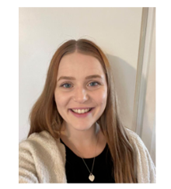
Year 4 Meet the Teacher 2024/25
Miss Walsh

Slide 2
Where we are
Children enter through the entrance in the staff car park.
Children walk straight ahead and go up the stairs to their classrooms above the Reception classrooms
Pick up from the KS2 playground entrance – the same as last year

Slide 3
English
Writing opportunities – freeze frames, visualisations, poetry, letter of advice, diary entries, writing in role and speeches.
Drama
Character building
Book Talk

Slide 4
Maths
Place Value : Counting in 1000’s; rounding to the nearest 10 and 100; comparing and ordering numbers; roman numerals
Addition and Subtraction: add/subtract 1,10,100,1000; add/subtract two 3 and 4 digit numbers – no exchanging and with exchanging.
Length and Perimeter: Equivalent lengths m and cm/ mm and cm; Kilometres; Add/subtract lengths; perimeter on a grid; perimeter of a rectangle and rectilinear shapes.
Multiplication and Division: multiply and divide by 10 and 100; multiply by 1 and 0; multiplication and division facts in the 3,6,7 and 9 times table

Slide 5
Reading – School
Exciting texts at each child’s level with activities to assess their understanding.
Understanding different characteristics of the text using VIPERS.
These help children grow as readers and understand the authors intentions.

Slide 6
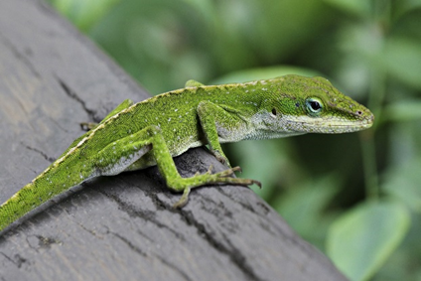
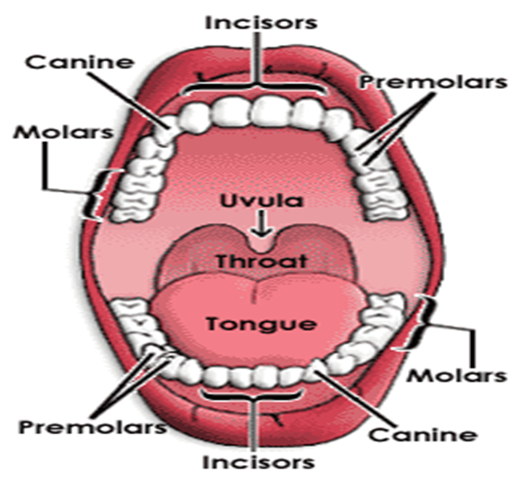
Science
Living things and their habitats
Grouping living things
Classifying vertebrate
Classification Keys
Local habitat survey
Environmental change
Animals including humans
Digestive system Parts
Digestive system function
Types and Functions of teeth
Tooth decay enquiry parts 1 and 2
Food chains

Slide 7
History – The Romans
Working as a historian/archeologist
Roman invasion of Great Britain
Placing events on a timeline
Asking questions about the past and answering them using different sources of evidence.
Describe different accounts of historical events.
Write in role to describe the Roman’s ideologies, beliefs, and attitudes towards gender differences.
Use appropriate vocabulary to talk about history.
Understand what the Romans did for us.

Slide 8
Geography
United Kingdom and Europe
To ask and answer questions about what a settlement is and to understand where and why the first people settled in Britain.
To understand where Italy and Rome are in relation to United Kingdom.
Locate Europe using Google Earth, Atlases and globes.
Use aerial photographs, compasses and grids to locate Europe in relation to the United Kingdom.
Use Google Earth and Atlases to explore the human and physical features of Europe.

Slide 9
Reading - Home
Reading for pleasure. ☺
Read at home 3 times a week to get a raffle ticket
Record this in your reading record.
Hand in every Guided Reading session to Miss Walsh
Raffle ticket drawn in special mentions assembly every Friday.

Slide 10
Times Tables
Year 4 have to take a times table test in June.
We practise at school, but it would be really helpful if you could practise them at home.
Every time they learn a times table out of order they receive a certificate in Special Mentions assembly.

Slide 11
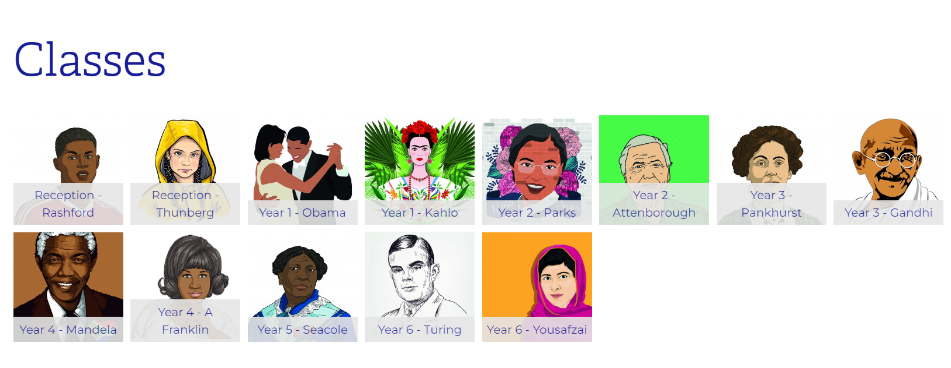
School Website

Slide 12
Rock up and Read & Special Mentions
Friday morning 08:40-08:55am
Special Mentions/Maths Mission/Star Badges: Text sent out a week in advance to invite you along to the following Friday.

Slide 13
Dates for the Diaries
PE days: Monday – Basketball
Friday - Gymnaastics
Computing Day: Wednesday
Library Day: Thursday

Slide 14
Any Questions?

