Slide 1


Year 5 Meet the Teacher
Spring Term
Mr Jones | Miss Farrow| Mrs M | Mrs Martin-Pepper
https://www.rudyardkiplingprimary.co.uk/

Slide 2
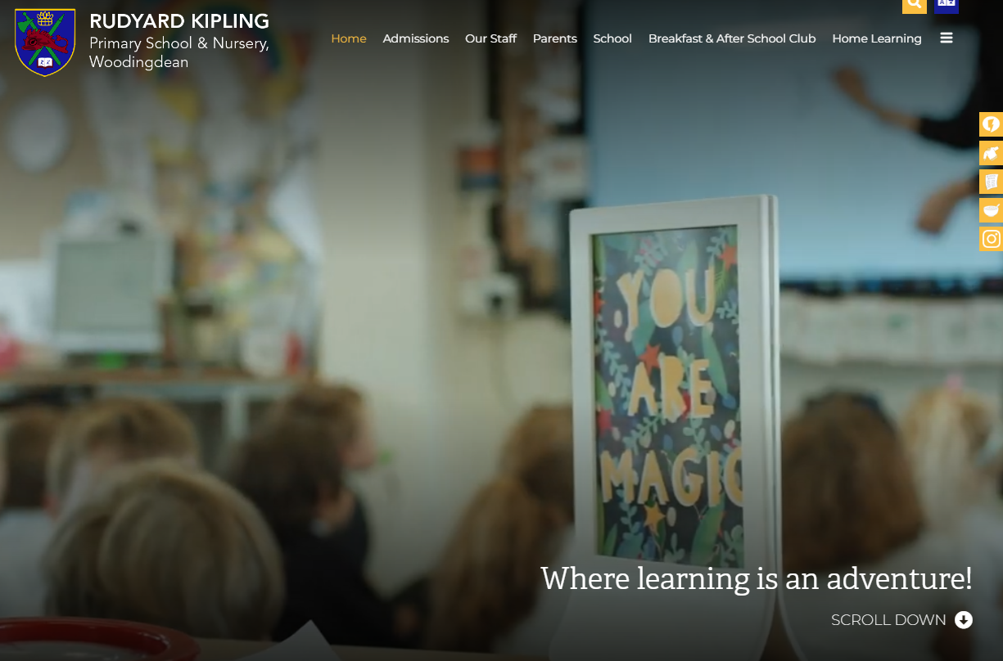
Website
https://www.rudyardkiplingprimary.co.uk/

Slide 3



English
World Book Day - TBC

Slide 4

Space
Describe the movement of the Earth, and other planets, relative to the Sun in the solar system
Describe the movement of the Moon relative to the Earth
Describe the Sun, Earth and Moon as approximately spherical bodies.
Use the idea of the Earth’s rotation to explain day and night, and the apparent movement of the sun across the sky.
Explain that unsupported objects fall towards the Earth because of the force of gravity acting between the Earth and the falling object

Slide 5
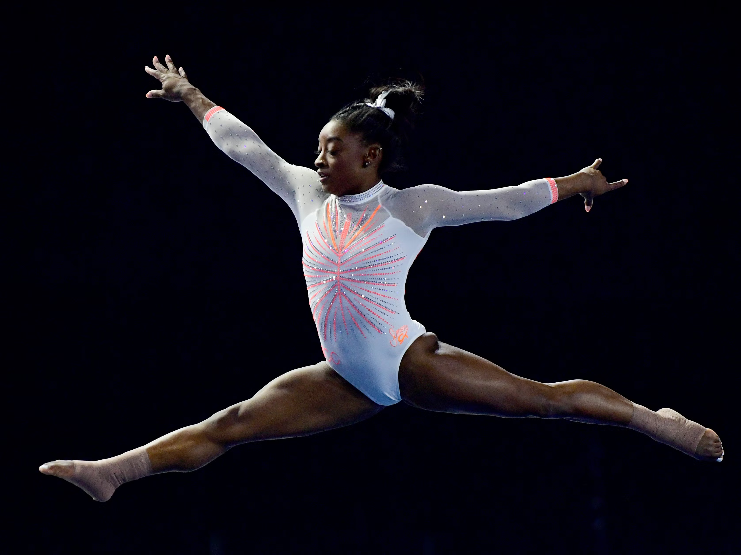
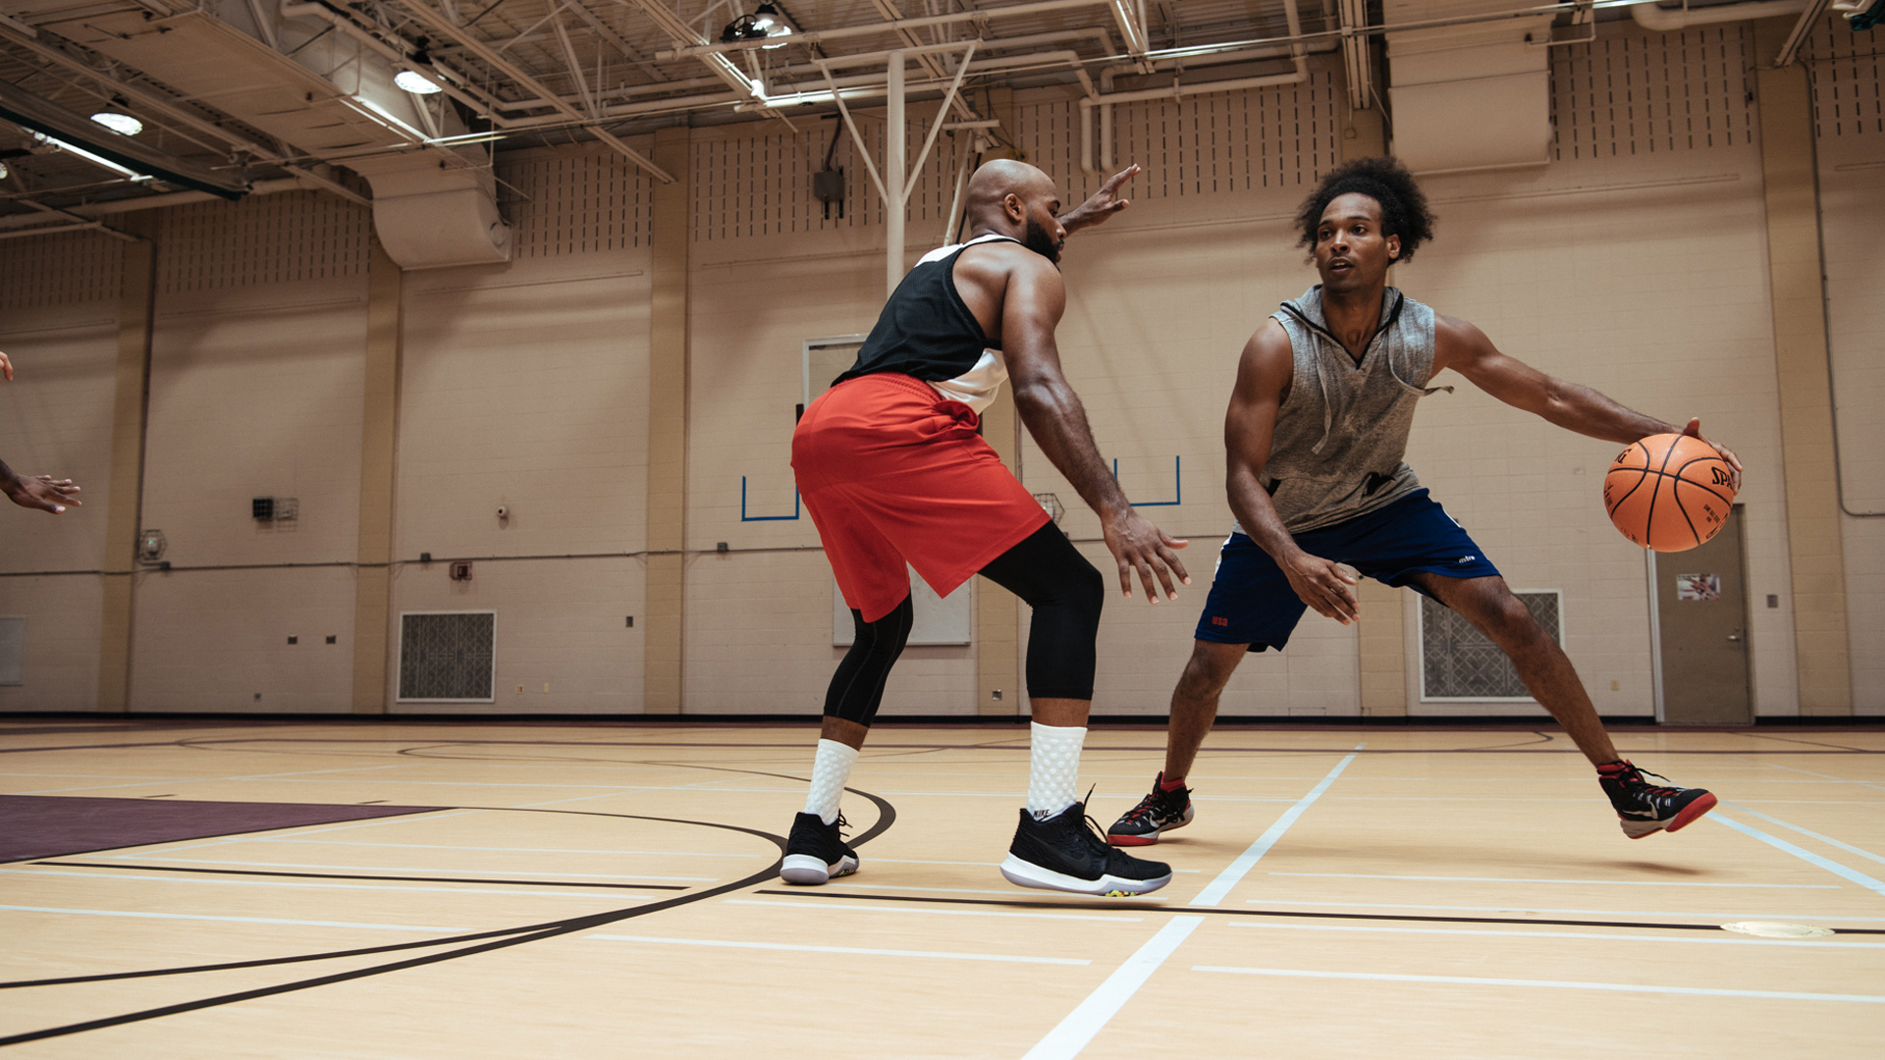
PE
Tuesday and Friday
  Gymnastic (continued from Autumn Term)
  Basketball
All children need to have a PE kit. This is made up of the school navy PE t-shirt, dark shorts or navy joggers and plimsolls/trainers. However your children are welcome to wear a plain navy t-shirt.
Make sure trainers are comfortable.

Slide 6
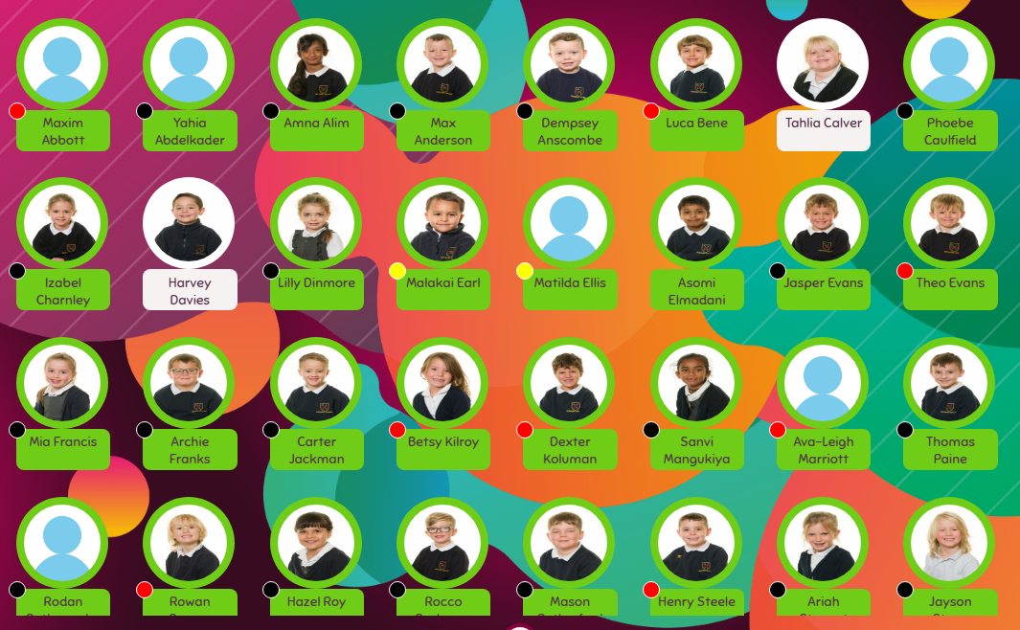

Meal Manager
Have a look at our menu for the Spring Term.
We suggest sitting down and highlighting the meals that you like, and then on the days that there’s nothing to take your fancy, bring in a packed lunch.
Don’t forget we are a nut-free school ☺

Slide 7

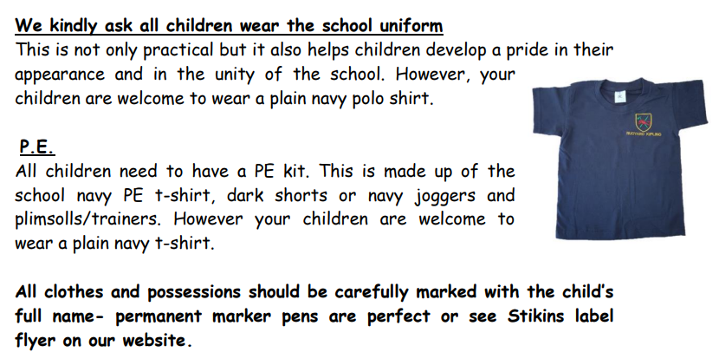
https://www.rudyardkiplingprimary.co.uk/assets/Documents/Attachments/School-Uniform-Code-2024-v3.pdf

Slide 8

Rock up and Read & Special Mentions Assembly
Friday morning 0840-0900
Special Mentions: Text sent out a week in advance to invite you along to the following Friday.
Star Badges and Maths Mission certificates also given on Friday

Slide 9

Reading - Home
Reading for pleasure. ☺
Read at home 3 times a week
Record this in your reading record.
Hand in every Monday to Mrs Martin-Pepper and Miss Farrow
Raffle ticket drawn in special mentions assembly every Friday.
Reading suggestions on home support sheet ☺

Slide 10

Times Tables
When children can recall their times tables, they become more confident, which can help them tackle more challenging math problems.
Please continue to practise these at home to secure them

Slide 11

Spelling Shed
You can download the app (for a small cost).
Your child will have a login (paid for by the school)
Fun interactive ways of learning tricky spellings.

Slide 12

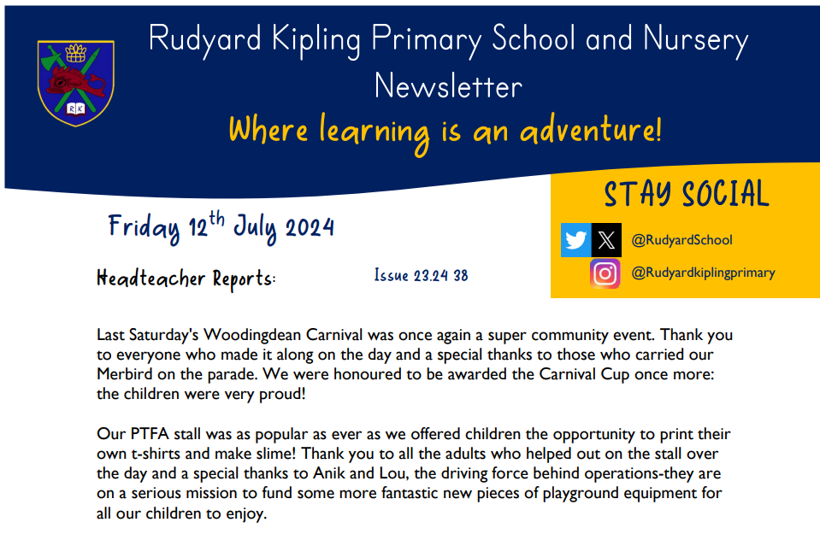
Communication
Rudyard Kipling Primary School and Nursery Newsletter.
School PING – Please download the app and sign in.
Details are available from the office.
Catchup at the end of the day.

Slide 13
Dates for the Diaries
PE Days: Tuesday and Friday
Computing Day: Thursdays PM
Library Day: Thursdays
School Trip: Chichester Planetarium (Tuesday 11th March 2025)

Slide 14






Home Learning apps
TTRS; Spelling Shed; Google Classroom:
Logins: surnam:@rkps.me
Password: words123
Duolingo; White Rose 1minute maths: Free Apps

Slide 15
Any questions?

