Slide 1

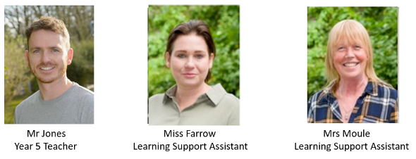
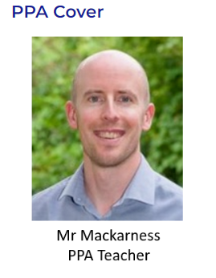
Year 5 Meet the Teacher 2024/25
Mr Jones | Miss Farrow| Mrs M | Mr Mack(PPA)
https://www.rudyardkiplingprimary.co.uk/

Slide 2
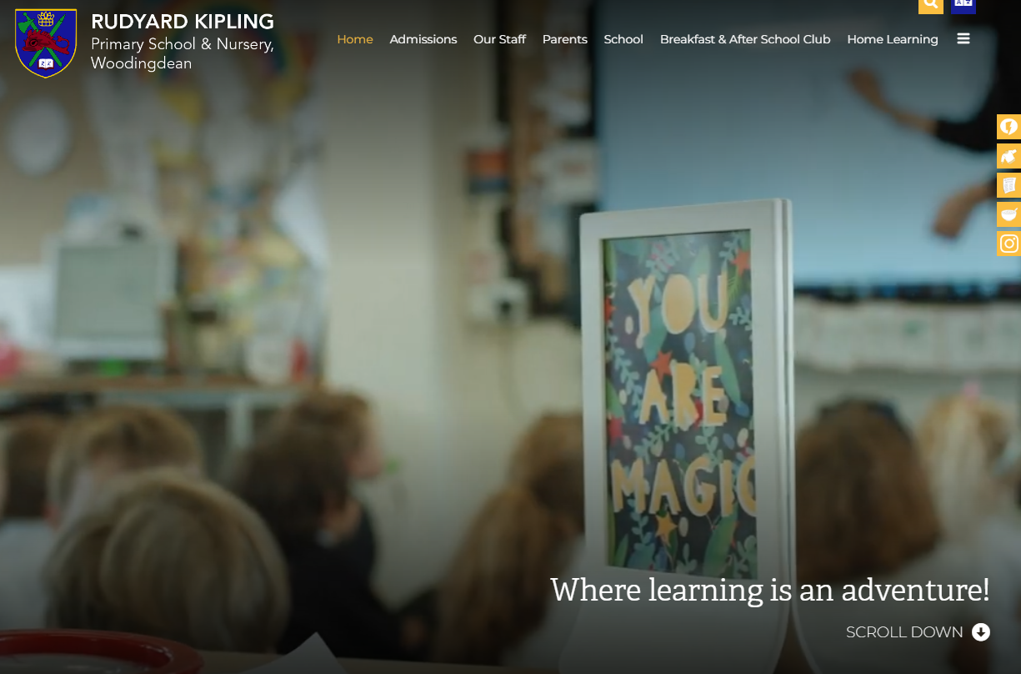
Website
https://www.rudyardkiplingprimary.co.uk/

Slide 3
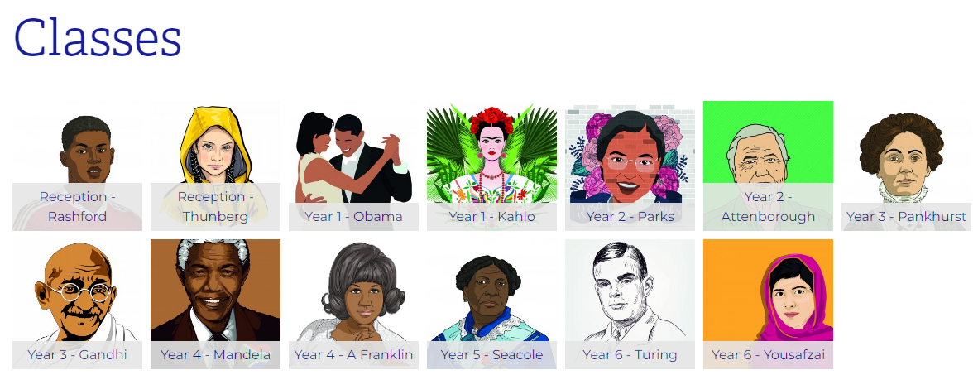

Slide 4
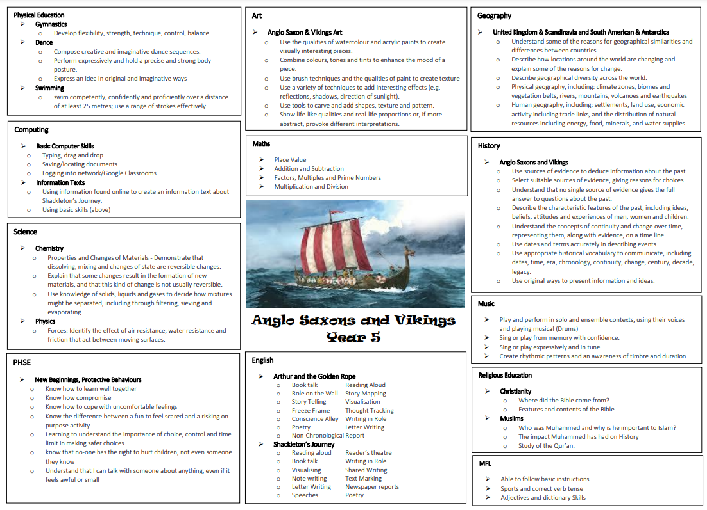

Slide 5
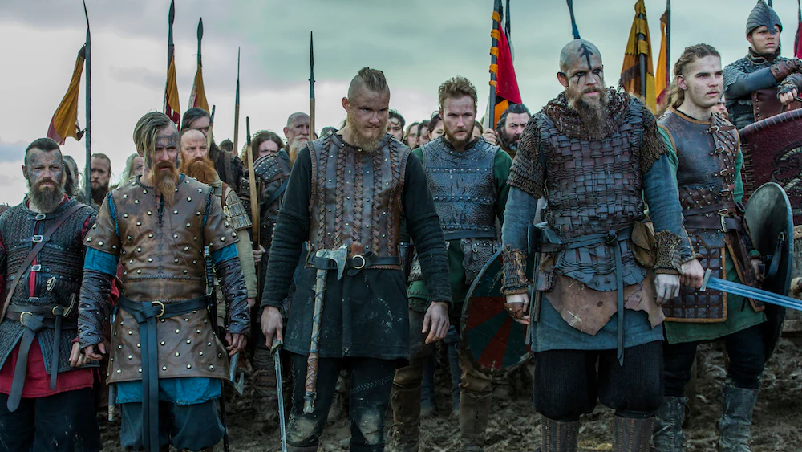
History – The Vikings & Anglo Saxons
Working as a historian/archaeologist
Who were the Vikings and Anglo Saxons?
Why and how did the Vikings invade?
How did the Saxons deal with the Vikings? What happened in a
Viking raid
Viking and Anglo Saxon life (similarities and differences)
Viking long ships construction and design

Slide 6
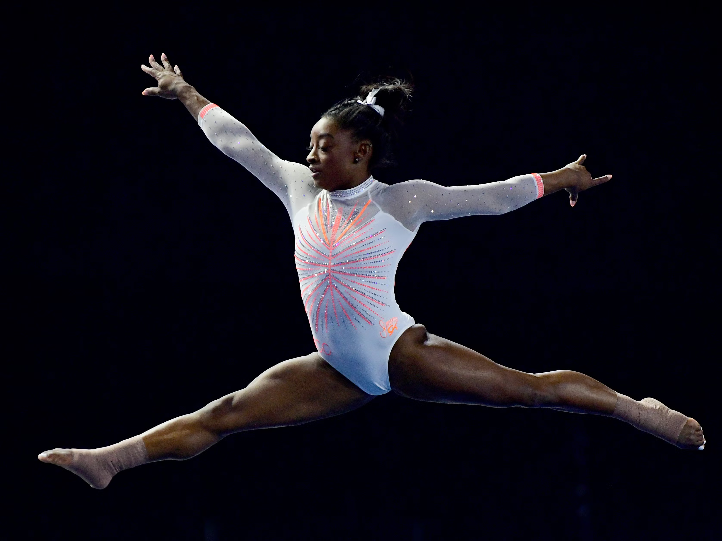
PE
Monday & Friday: PE Kit Comfortable trainers
Swimming: Monday mornings
Swimming costumes
Goggles
Towels
Snack
Underwear
Gymnastics/Dance

Slide 7
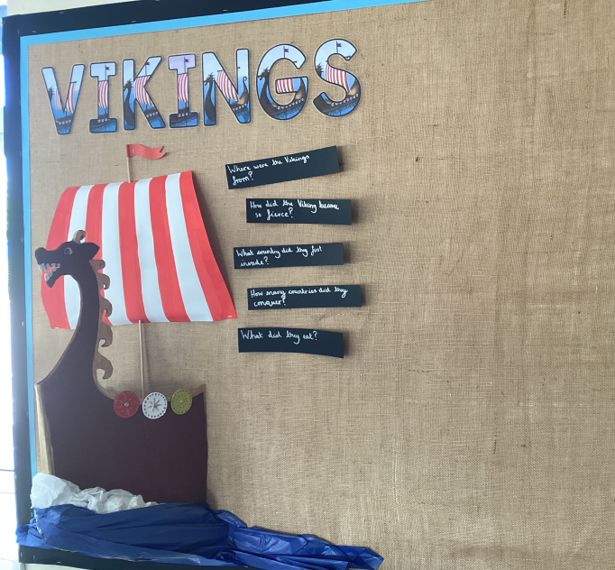
Classroom
We are in the same classroom as last year on the KS2 playground.
Please enter through the entrance most convenient for you (08:40)
Pick up from the KS2 playground opposite ‘the stage’
Mr Jones/Mr Mack will dismiss at the end of the day (15:15)

Slide 8
Meal Manager

Slide 9
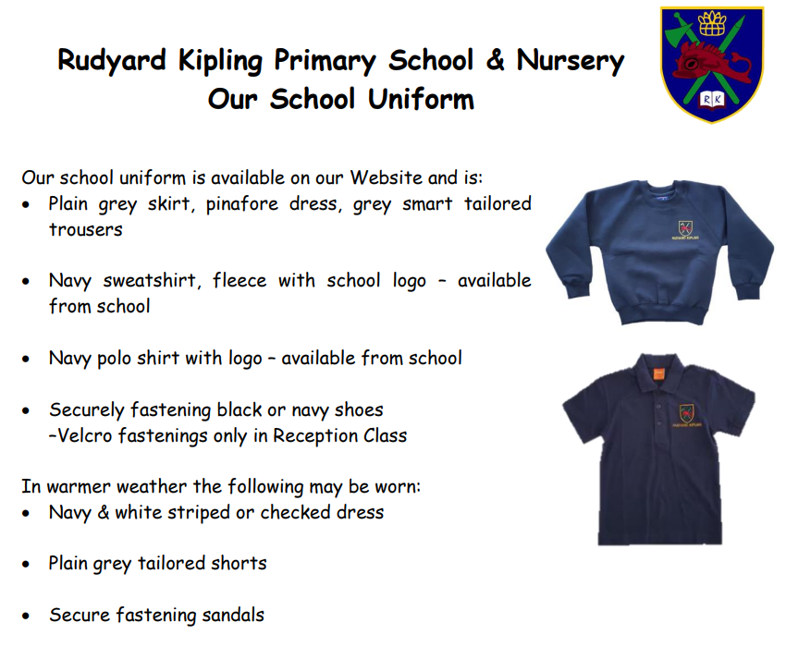
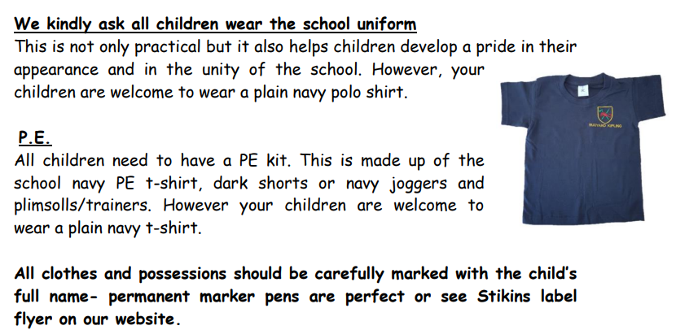
https://www.rudyardkiplingprimary.co.uk/assets/Documents/Attachments/School-Uniform-Code-2024-v3.pdf

Slide 10

Rock up and Read & Special Mentions Assembly
Friday morning 0840-0900
Special Mentions: Text sent out a week in advance to invite you along to the following Friday.
Star Badges and Maths Mission certificates also given on Friday

Slide 11

Reading - Home
Reading for pleasure. ☺
Read at home 3 times a week
Record this in your reading record.
Hand in every Monday to Mrs M and Miss Farrow
Raffle ticket drawn in special mentions assembly every Friday.
Reading suggestions on home support sheet ☺

Slide 12

Times Tables
When children can recall their times tables, they become more confident, which can help them tackle more challenging math problems.
Please continue to practise these at home to secure them

Slide 13

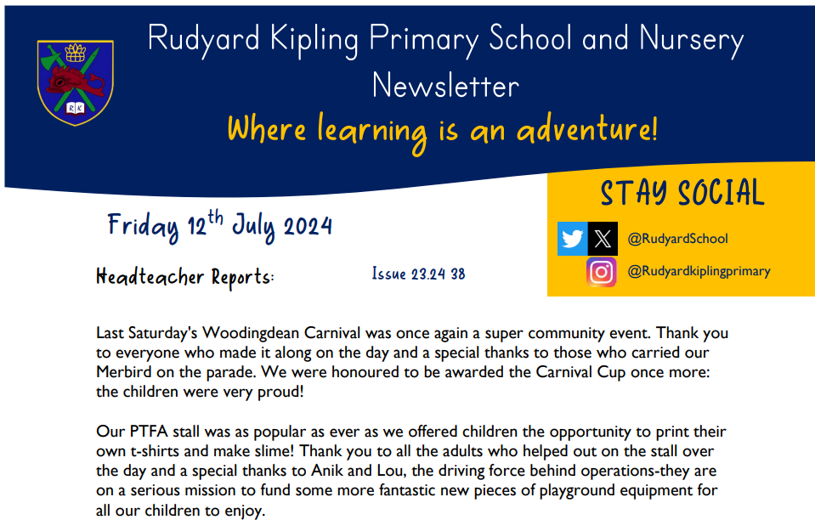
Communication
Rudyard Kipling Primary School and Nursery Newsletter.
School PING – Please download the app and sign in.
Details are available from the office.
Catchup at the end of the day.

Slide 14
Dates for the Diaries
Swimming: Monday mornings at Brighton Swimming Centre
Swimming costumes
Goggles
Towel
Healthy Snack
Underwear
Christmas Production: TBC
Computing Day: Thursdays
Library Day: Thursdays

Slide 15





Home Learning apps
TTRS; Spelling Shed; Google Classroom:
Logins: surnam:@rkps.me
Password: words123
Duolingo; White Rose 1minute maths: Free Apps

Slide 16
Any questions?

